Slide 1



How to identify which user is running which query?
How to delete the profiler collection ?

Slide 2
What is Sharding?

Slide 3
Sharding Overview
Application
Driver
…
…
Query Router
Query Router
Query Router
Shard 1
Shard 2
Shard 3
Shard N
Primary
Primary
Primary
Primary
…
Secondary
Secondary
Secondary
Secondary
Secondary
Secondary
Secondary
Secondary

Slide 4

Automatic Sharding
Three types of sharding: hash-based, range-based, tag-aware
Increase or decrease capacity as you go
Automatic balancing
Notes:
MongoDB provides horizontal scale-out for databases using a technique called sharding, which is trans- parent to applications. Sharding distributes data across multiple physical partitions called shards. Sharding allows MongoDB deployments to address the hardware limitations of a single server, such as bottlenecks in RAM or disk I/O, without adding complexity to the application.
MongoDB supports three types of sharding:
• Range-based Sharding. Documents are partitioned across shards according to the shard key value. Documents with shard key values “close” to one another are likely to be co-located on the same shard. This approach is well suited for applications that need to optimize range- based queries.
• Hash-based Sharding. Documents are uniformly distributed according to an MD5 hash of the shard key value. Documents with shard key values “close” to one another are unlikely to be co-located on the same shard. This approach guarantees a uniform distribution of writes across shards, but is less optimal for range-based queries.
• Tag-aware Sharding. Documents are partitioned according to a user-specified configuration that associates shard key ranges with shards. Users can optimize the physical location of documents for application requirements such as locating data in specific data centers.
MongoDB automatically balances the data in the cluster as the data grows or the size of the cluster increases or decreases.

Slide 5

Scaling: Sharding
Key Range
0..100
mongod
Read/Write Scalability

Slide 6
Scaling: Sharding
Key Range
0..50
Key Range
51..100
mongod
mongod
Read/Write Scalability

Slide 7
Scaling: Sharding
Key Range
0..25
Key Range
26..50
Key Range
51..75
Key Range
76.. 100
mongod
mongod
mongod
mongod
Read/Write Scalability

Slide 8
How do I know I need to shard?

Slide 9
Does one server/replica…
Have enough disk space to store all my data?
Handle my query throughput (operations per second)?
Respond to queries fast enough (latency)?

Slide 10
Does one server/replica set…
Server Specs
Disk Capacity
Disk IOPS
RAM
Network
Disk IOPS
RAM
Network
Have enough disk space to store all my data?
Handle my query throughput (operations per second)?
Respond to queries fast enough (latency)?

Slide 11
How many shards do I need?

Slide 12
Disk Space: How Many Shards Do I Need?
Sum of disk space across shards > greater than required storage size

Slide 13
Disk Space: How Many Shards Do I Need?
Sum of disk space across shards > greater than required storage size
Example
Storage size = 3 TB
Server disk capacity = 2 TB
2 Shards Required

Slide 14
RAM: How Many Shards Do I Need?
Working set should fit in RAM
Sum of RAM across shards > Working Set
WorkSet = Indexes plus the set of documents accessed frequently
WorkSet in RAM ➔
Shorter latency
Higher Throughput

Slide 15
RAM: How Many Shards Do I Need?
Measuring Index Size and Working Set
db.stats() – index size of each collection
db.serverStatus({ workingSet: 1}) – working set size estimate

Slide 16
RAM: How Many Shards Do I Need?
Measuring Index Size and Working Set
db.stats() – index size of each collection
db.serverStatus({ workingSet: 1}) – working set size estimate
Example
Working Set = 428 GB
Server RAM = 128 GB
428/128 = 3.34
4 Shards Required

Slide 17
Types of Sharding

Slide 18
Sharding Types
Range
Tag-Aware
Hashed

Slide 19
Range Sharding
Key Range
0..25
Key Range
26..50
Key Range
51..75
Key Range
76.. 100
mongod
mongod
mongod
mongod
Read/Write Scalability

Slide 20
Tag-Aware Sharding
Tag Ranges
Shard Tag | Start | End
Winter | 23 Dec | 21 Mar
Spring | 22 Mar | 21 Jun
Summer | 21 Jun | 23 Sep
Fall | 24 Sep | 22 Dec
Shard Tags
Winter
Spring
Summer
Fall
mongod
mongod
mongod
mongod

Slide 21
Hash-Sharding
Hash Range
0000..4444
Hash Range
4445..8000
Hash Range
i8001..aaaa
Hash Range
aaab..ffff
mongod
mongod
mongod
mongod

Slide 22
Hashed shard key
Pros:
Evenly distributed writes
Cons:
Random data (and index) updates can be IO intensive
Range-based queries turn into scatter gather
mongos
Shard 1
Shard 2
Shard 3
Shard N

Slide 23
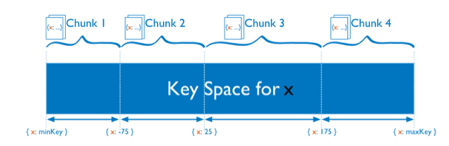
Range sharding document distribution

Slide 24
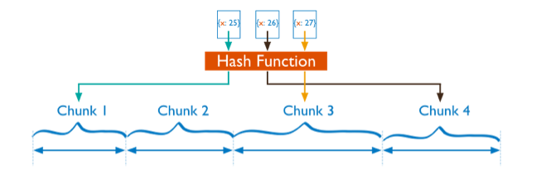
Hashed sharding document distribution

Slide 25
How do I Pick A Shard Key

Slide 26
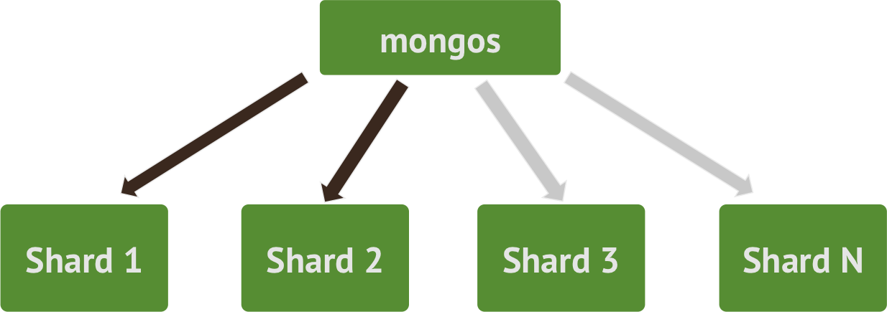
Shard Key characteristics
A good shard key has:
sufficient cardinality
distributed writes
targeted reads ("query isolation")
Shard key should be in every query if possible
scatter gather otherwise
Choosing a good shard key is important!
affects performance and scalability
changing it later is expensive

Slide 27
Ascending shard key
Monotonically increasing shard key values cause "hot spots" on inserts
Examples: timestamps, _id
mongos
[ ISODate(…), $maxKey )
Shard 1
Shard 2
Shard 3
Shard N
Notes:
may consider hashing _id instead

Slide 28
Reasons to Shard

Slide 29
Reasons to shard
Scale
Data volume
Query volume
Global deployment with local writes
Geography aware sharding
Tiered Storage
Fast backup restore

Slide 30
Global Deployment/Local Writes
Primary:LON
Secondary:NYC
Primary:NYC
Secondary:SYD
Secondary:LON
Secondary:SYD
Primary:SYD
Secondary:LON
Secondary:NYC

Slide 31
Tiered Storage
Save hardware costs
Put frequently accessed documents on fast servers
Infrequently accessed documents on less capable servers
Use Tag aware sharding
Current
Current
Archive
Archive
mongod
mongod
mongod
mongod
SSD
SSD
HDD
HDD

Slide 32
Fast Restore
40 TB Database
2 shards of 20 TB each
mongod
mongod
20 TB
20 TB

Slide 33
Fast Restore
40 TB Database
4 shards of 10 TB each
Solution
Reduce the restore time by 50%
mongod
mongod
mongod
mongod
10 TB
10 TB
10 TB
10 TB

Slide 34
Sharding: Where to go from here…
MongoDB Manual: http://docs.mongodb.org/manual/sharding/
Other Webinars:
How to Achieve Scale With MongoDB
White Papers
MongoDB Performance Best Practices
MongoDB Architecture Guide

Slide 35

what is config server?
What is mongos.exe?

Slide 36
Thank you for your attention!

